Slide 1
Statistics
(16 hours)
Notes:
Title - The learning outcome
Subtitle - Duration

Slide 2
In this section, we will discuss:
Introduction to descriptive statistics and inferential statistics
Measure of central tendency and spread.
Types of distributions-uniform, binomial, normal, log, exp
Sampling techniques, population
Notes:
Mention the parent topics one by one. This particular learning outcome has 4 parent topics.

Slide 3
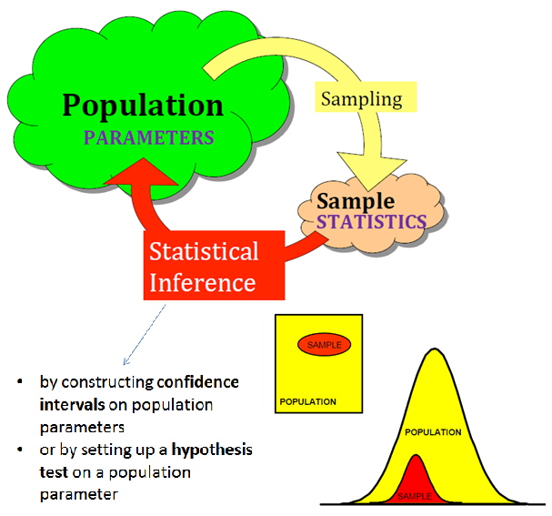
Inferential Statistics
Introduction to Inferential statistics
Inferential statistics is a scientific discipline that uses mathematical tools to make forecasts and projections by analyzing the given data.
This is of use to people employed in such fields as engineering, economics, biology, the social sciences, business, agriculture and communications.
Image Source: https://mahritaharahap.wordpress.com/teaching-areas/inferential-stati
Notes:
Left (White Color space):
Title - Parent Topic
Subtitle - Subtopic 1
Body Text - Description in bullets
Right (Grey Color Space):
Body Text - Relevant image (with source)/code snippet
Put reference links in Speaker Notes
Reference:
https://www.tutorialspoint.com/internet_technologies/internet_overview.htm/

Slide 4
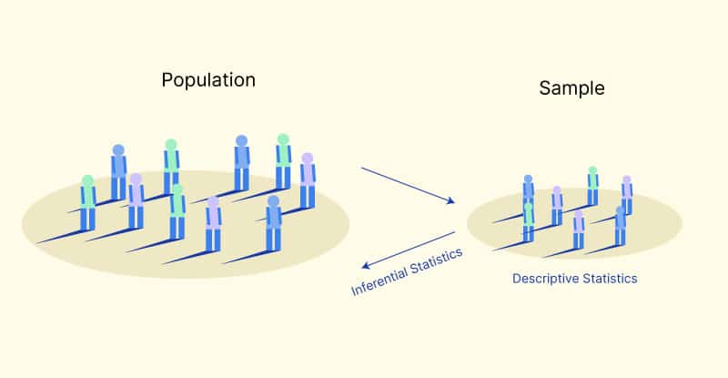
Inferential Statistics
Advantages of Inferential statistics
A precise tool for estimating population.
Highly structured analytical methods.
Image Source: /
Notes:
Left (White Color space):
Title - Parent Topic
Subtitle - Subtopic 1
Body Text - Description in bullets
Right (Grey Color Space):
Body Text - Relevant image (with source)/code snippet
Put reference links in Speaker Notes
Reference:
https://www.tutorialspoint.com/internet_technologies/internet_overview.htm/

Slide 5
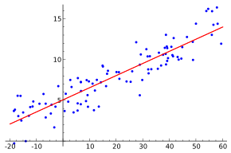
Inferential Statistics
Inferential Statistics Examples
Regression Analysis is one of the most popular analysis tools.
Regression analysis is used to predict the relationship between independent variables and the dependent variable.
Image Source: /
Notes:
Left (White Color space):
Title - Parent Topic
Subtitle - Subtopic 1
Body Text - Description in bullets
Right (Grey Color Space):
Body Text - Relevant image (with source)/code snippet
Put reference links in Speaker Notes
Reference:
https://www.tutorialspoint.com/internet_technologies/internet_overview.htm/

Slide 6
Inferential Statistics
Inferential Statistics Examples
Hypothesis testing is a statistical test where we want to know the truth of an assumption or opinion that is common in society.
Confidence interval or confidence level is a statistical test used to estimate the population by using samples.
Image Source: /
Notes:
Left (White Color space):
Title - Parent Topic
Subtitle - Subtopic 1
Body Text - Description in bullets
Right (Grey Color Space):
Body Text - Relevant image (with source)/code snippet
Put reference links in Speaker Notes
Reference:
https://www.tutorialspoint.com/internet_technologies/internet_overview.htm/

Slide 7
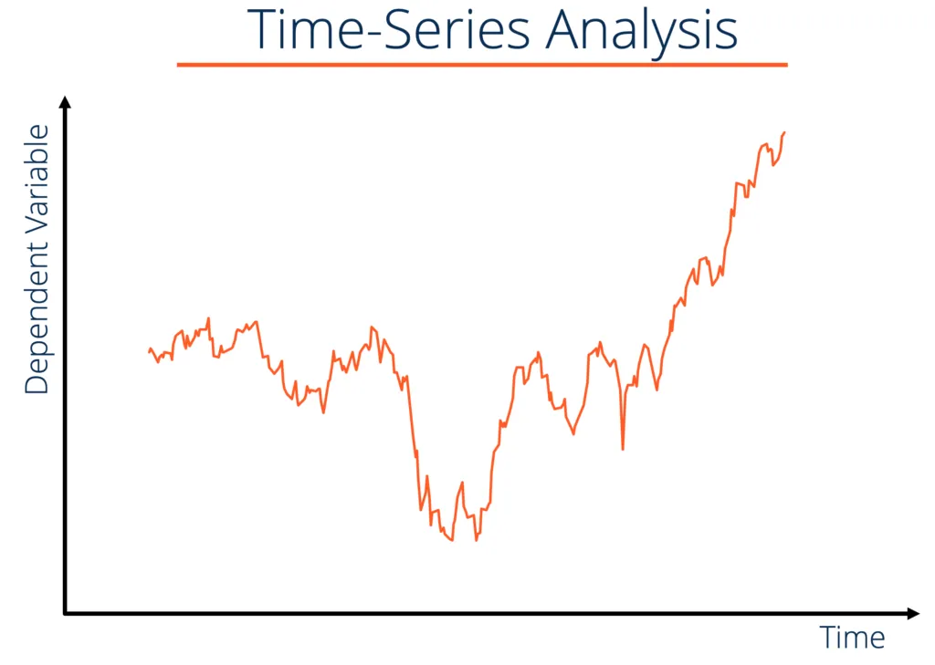
Inferential Statistics
Inferential Statistics Examples
Time series analysis is one type of statistical analysis that tries to predict an event in the future based on pre-existing data.
With this method, we can estimate how predictions a value or event that appears in the future.
Image Source: /
Notes:
Left (White Color space):
Title - Parent Topic
Subtitle - Subtopic 1
Body Text - Description in bullets
Right (Grey Color Space):
Body Text - Relevant image (with source)/code snippet
Put reference links in Speaker Notes
Reference:
https://www.tutorialspoint.com/internet_technologies/internet_overview.htm/

Slide 8
Descriptive Statistics
Introduction to descriptive statistics
It is used to describe the basic features of data in a study.
Descriptive statistics deals with the processing of data without attempting to draw any inferences from it.
The data are presented in the form of tables and graphs.
Image Source: /
Notes:
Left (White Color space):
Title - Parent Topic
Subtitle - Subtopic 1
Body Text - Description in bullets
Right (Grey Color Space):
Body Text - Relevant image (with source)/code snippet
Put reference links in Speaker Notes
Reference:
https://www.tutorialspoint.com/internet_technologies/internet_overview.htm/

Slide 9
Descriptive Statistics
Introduction to descriptive statistics
The characteristics of the data are described in simple terms.
Events that are dealt with include everyday happenings such as accidents, prices of goods, business, incomes, epidemics, sports data, population data.
Image Source: https://data-flair.training/blogs/stat-descriptive-statistics/
Notes:
Left (White Color space):
Title - Parent Topic
Subtitle - Subtopic 1
Body Text - Description in bullets
Right (Grey Color Space):
Body Text - Relevant image (with source)/code snippet
Put reference links in Speaker Notes
Reference:
https://www.tutorialspoint.com/internet_technologies/internet_overview.htm/

Slide 10
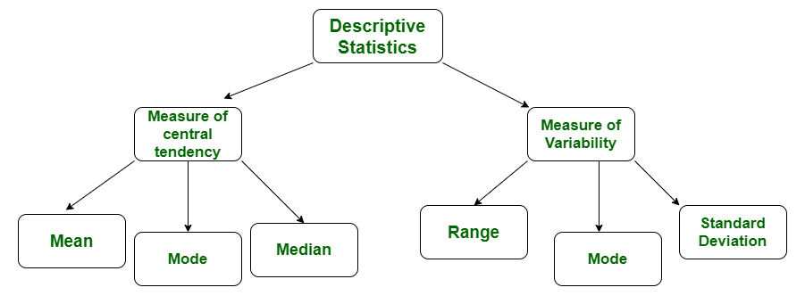
Descriptive Statistics
Types of descriptive statistics
All descriptive statistics are either measures of central tendency or measures of variability, also known as measures of dispersion.
Image Source: https://www.geeksforgeeks.org/difference-between-descriptive-and-inferential-statistics/
Notes:
Left (White Color space):
Title - Parent Topic
Subtitle - Subtopic 1
Body Text - Description in bullets
Right (Grey Color Space):
Body Text - Relevant image (with source)/code snippet
Put reference links in Speaker Notes
Reference:
https://www.tutorialspoint.com/internet_technologies/internet_overview.htm/

Slide 11
Descriptive Statistics
Measure of Central Tendency
Measures of central tendency focus on the average or middle values of data sets.
These measures indicate where most values in a distribution fall and are also referred to as the central location of a distribution.
Image Source: http://www.brainkart.com/article/Various-measures-of-central-tendency_35079/
Notes:
Left (White Color space):
Title - Parent Topic
Subtitle - Subtopic 1
Body Text - Description in bullets
Right (Grey Color Space):
Body Text - Relevant image (with source)/code snippet
Put reference links in Speaker Notes
Reference:
https://www.tutorialspoint.com/internet_technologies/internet_overview.htm/

Slide 12
Descriptive Statistics
Measure of Central Tendency continued…
We can think of it as the tendency of data to cluster around a middle value.
In statistics the three most common measures of central tendency are the mean, median and mode.
Image Source: http://www.brainkart.com/article/Various-measures-of-central-tendency_35079/
Notes:
Left (White Color space):
Title - Parent Topic
Subtitle - Subtopic 1
Body Text - Description in bullets
Right (Grey Color Space):
Body Text - Relevant image (with source)/code snippet
Put reference links in Speaker Notes
Reference:
https://www.tutorialspoint.com/internet_technologies/internet_overview.htm/

Slide 13
Descriptive Statistics
Measure of Central Tendency continued…
Each of these measures calculates the location of the central point using a different method.
Choosing the best measure of central tendency depends on the type of data we have.
Image Source: http://www.brainkart.com/article/Various-measures-of-central-tendency_35079/
Notes:
Left (White Color space):
Title - Parent Topic
Subtitle - Subtopic 1
Body Text - Description in bullets
Right (Grey Color Space):
Body Text - Relevant image (with source)/code snippet
Put reference links in Speaker Notes
Reference:
https://www.tutorialspoint.com/internet_technologies/internet_overview.htm/

Slide 14
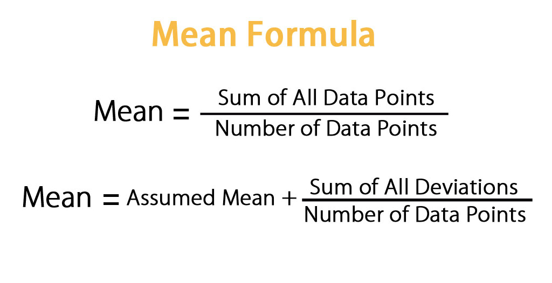
Measure of Central Tendency
Mean
The mean is the arithmetic average, and it is probably the measure of central tendency that you are most familiar.
Calculating the mean is very simple.
Image Source:
Notes:
Left (White Color space):
Title - Parent Topic
Subtitle - Subtopic 1
Body Text - Description in bullets
Right (Grey Color Space):
Body Text - Relevant image (with source)/code snippet
Put reference links in Speaker Notes
Reference:
https://www.tutorialspoint.com/internet_technologies/internet_overview.htm/

Slide 15
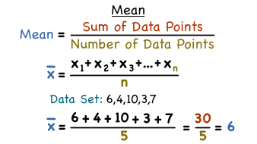
Measure of Central Tendency
Mean continued…
We just add up all of the values and divide by the number of observations in your dataset.
x1+x2+x3+.....+xn
_______________
n
Image Source:
Notes:
Left (White Color space):
Title - Parent Topic
Subtitle - Subtopic 1
Body Text - Description in bullets
Right (Grey Color Space):
Body Text - Relevant image (with source)/code snippet
Put reference links in Speaker Notes
Reference:
https://www.tutorialspoint.com/internet_technologies/internet_overview.htm/

Slide 16
Measure of Central Tendency
Mean continued…
The calculation of the mean incorporates all values in the data.
If you change any value, the mean changes.
However, the mean doesn’t always locate the center of the data accurately.
Image Source:
Notes:
Left (White Color space):
Title - Parent Topic
Subtitle - Subtopic 1
Body Text - Description in bullets
Right (Grey Color Space):
Body Text - Relevant image (with source)/code snippet
Put reference links in Speaker Notes
Reference:
https://www.tutorialspoint.com/internet_technologies/internet_overview.htm/

Slide 17
Measure of Central Tendency
Mean continued…
In a symmetric distribution, the mean locates the center accurately.
Image Source :https://statisticsbyjim.com/basics/measures-central-tendency-mean-median-mode/
Notes:
Left (White Color space):
Title - Parent Topic
Subtitle - Subtopic 1
Body Text - Description in bullets
Right (Grey Color Space):
Body Text - Relevant image (with source)/code snippet
Put reference links in Speaker Notes
Reference:
https://www.tutorialspoint.com/internet_technologies/internet_overview.htm/

Slide 18
Measure of Central Tendency
Mean continued…
However, in a skewed distribution, the mean can miss the mark.
This problem occurs because outliers have a substantial impact on the mean.
Extreme values in an extended tail pull the mean away from the center.
As the distribution becomes more skewed, the mean is drawn further away from the center.
​Image Source :https://statisticsbyjim.com/basics/measures-central-tendency-mean-median-mode/
Notes:
Left (White Color space):
Title - Parent Topic
Subtitle - Subtopic 1
Body Text - Description in bullets
Right (Grey Color Space):
Body Text - Relevant image (with source)/code snippet
Put reference links in Speaker Notes
Reference:
https://www.tutorialspoint.com/internet_technologies/internet_overview.htm/

Slide 19
Measure of Central Tendency
Median
The median is the middle value.
It is the value that splits the dataset in half.
To find the median, order your data from smallest to largest, and then find the data point that has an equal amount of values above it and below it.
Image Source: http://www.brainkart.com/article/Various-measures-of-central-tendency_35079/
Notes:
Left (White Color space):
Title - Parent Topic
Subtitle - Subtopic 1
Body Text - Description in bullets
Right (Grey Color Space):
Body Text - Relevant image (with source)/code snippet
Put reference links in Speaker Notes
Reference:
https://www.tutorialspoint.com/internet_technologies/internet_overview.htm/

Slide 20
Measure of Central Tendency
Median continued…
The method for locating the median varies slightly depending on whether your dataset has an even or odd number of values.
Image Source: http://www.brainkart.com/article/Various-measures-of-central-tendency_35079/
Notes:
Left (White Color space):
Title - Parent Topic
Subtitle - Subtopic 1
Body Text - Description in bullets
Right (Grey Color Space):
Body Text - Relevant image (with source)/code snippet
Put reference links in Speaker Notes
Reference:
https://www.tutorialspoint.com/internet_technologies/internet_overview.htm/

Slide 21
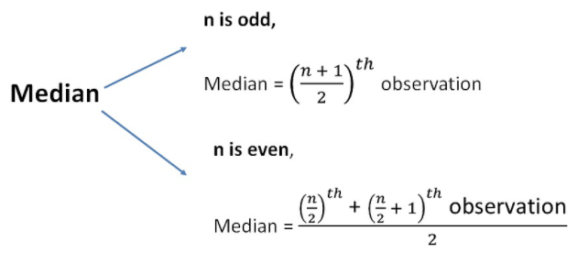
Measure of Central Tendency
Median continued…
In the dataset with the odd number of observations, notice how the number 12 has six values above it and six below it.
Therefore, 12 is the median of this dataset.
Image Source:
Notes:
Left (White Color space):
Title - Parent Topic
Subtitle - Subtopic 1
Body Text - Description in bullets
Right (Grey Color Space):
Body Text - Relevant image (with source)/code snippet
Put reference links in Speaker Notes
Reference:
https://www.tutorialspoint.com/internet_technologies/internet_overview.htm/

Slide 22
Measure of Central Tendency
Median continued…
When there is an even number of values, you count in to the two innermost values and then take the average.
The average of 27 and 29 is 28.
Consequently, 28 is the median of this dataset.
Image Source :https://statisticsbyjim.com/basics/measures-central-tendency-mean-median-mode/
Notes:
Left (White Color space):
Title - Parent Topic
Subtitle - Subtopic 1
Body Text - Description in bullets
Right (Grey Color Space):
Body Text - Relevant image (with source)/code snippet
Put reference links in Speaker Notes
Reference:
https://www.tutorialspoint.com/internet_technologies/internet_overview.htm/

Slide 23
Measure of Central Tendency
Mode
The mode is the value that occurs the most frequently in your data set.
On a bar chart, the mode is the highest bar.
If the data have multiple values that are tied for occurring the most frequently, you have a multimodal distribution.
If no value repeats, the data do not have a mode.
Image Source: http://www.brainkart.com/article/Various-measures-of-central-tendency_35079/
Notes:
Left (White Color space):
Title - Parent Topic
Subtitle - Subtopic 1
Body Text - Description in bullets
Right (Grey Color Space):
Body Text - Relevant image (with source)/code snippet
Put reference links in Speaker Notes
Reference:
https://www.tutorialspoint.com/internet_technologies/internet_overview.htm/

Slide 24
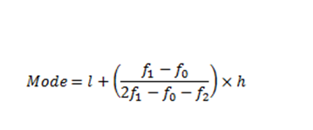
Measure of Central Tendency
Mode continued….
In the dataset, the value 5 occurs most frequently, which makes it the mode.
These data might represent a 5-point Likert scale.
Image Source: https://www.geeksforgeeks.org/difference-between-descriptive-and-inferential-statistics/
Notes:
Left (White Color space):
Title - Parent Topic
Subtitle - Subtopic 1
Body Text - Description in bullets
Right (Grey Color Space):
Body Text - Relevant image (with source)/code snippet
Put reference links in Speaker Notes
Reference:
https://www.tutorialspoint.com/internet_technologies/internet_overview.htm/

Slide 25
Measure of Central Tendency
Mode continued….
Typically, you use the mode with categorical, ordinal, and discrete data.
In fact, the mode is the only measure of central tendency that you can use with categorical data—such as the most preferred flavor of ice cream.
However, with categorical data, there isn’t a central value because you can’t order the groups.
Image Source :https://statisticsbyjim.com/basics/measures-central-tendency-mean-median-mode/
Notes:
Left (White Color space):
Title - Parent Topic
Subtitle - Subtopic 1
Body Text - Description in bullets
Right (Grey Color Space):
Body Text - Relevant image (with source)/code snippet
Put reference links in Speaker Notes
Reference:
https://www.tutorialspoint.com/internet_technologies/internet_overview.htm/

Slide 26
Measure of Central Tendency
Mode continued….
With ordinal and discrete data, the mode can be a value that is not in the center.
Again, the mode represents the most common value.
Image Source :https://statisticsbyjim.com/basics/measures-central-tendency-mean-median-mode/
Notes:
Left (White Color space):
Title - Parent Topic
Subtitle - Subtopic 1
Body Text - Description in bullets
Right (Grey Color Space):
Body Text - Relevant image (with source)/code snippet
Put reference links in Speaker Notes
Reference:
https://www.tutorialspoint.com/internet_technologies/internet_overview.htm/

Slide 27
Arithmetic mean
Definition
Arithmetic Mean in the most common and easily understood measure of central tendency.
We can define mean as the value obtained by dividing the sum of measurements with the number of measurements contained in the data set and is denoted by the symbol x bar
Image Source:
Notes:
Left (White Color space):
Title - Parent Topic
Subtitle - Subtopic 1
Body Text - Description in bullets
Right (Grey Color Space):
Body Text - Relevant image (with source)/code snippet
Put reference links in Speaker Notes
Reference:
https://www.tutorialspoint.com/internet_technologies/internet_overview.htm/

Slide 28
Arithmetic mean
Arithmetic Mean for three types of
series
Individual Data Series
Discrete Data Series
Continuous Data Series
Image Source:
Notes:
Left (White Color space):
Title - Parent Topic
Subtitle - Subtopic 1
Body Text - Description in bullets
Right (Grey Color Space):
Body Text - Relevant image (with source)/code snippet
Put reference links in Speaker Notes
Reference:
https://www.tutorialspoint.com/internet_technologies/internet_overview.htm/

Slide 29
Arithmetic mean
Individual Data Series
When data is given on individual basis.
Following is an example of individual series:
Items:
5 10 20 30 40 50 60 70
Image Source :https://statisticsbyjim.com/basics/measures-central-tendency-mean-median-mode/
Notes:
Left (White Color space):
Title - Parent Topic
Subtitle - Subtopic 1
Body Text - Description in bullets
Right (Grey Color Space):
Body Text - Relevant image (with source)/code snippet
Put reference links in Speaker Notes
Reference:
https://www.tutorialspoint.com/internet_technologies/internet_overview.htm/

Slide 30
Arithmetic mean
Individual Data Series continued…
Alternatively, we can write same formula as follows:
Image Source :https://www.tutorialspoint.com/statistics/discrete_series_arithmetic_mean.htm
Notes:
Left (White Color space):
Title - Parent Topic
Subtitle - Subtopic 1
Body Text - Description in bullets
Right (Grey Color Space):
Body Text - Relevant image (with source)/code snippet
Put reference links in Speaker Notes
Reference:
https://www.tutorialspoint.com/internet_technologies/internet_overview.htm/

Slide 31
Arithmetic mean
Individual Data Series continued…
Image Source :https://www.tutorialspoint.com/statistics/discrete_series_arithmetic_mean.htm
Notes:
Left (White Color space):
Title - Parent Topic
Subtitle - Subtopic 1
Body Text - Description in bullets
Right (Grey Color Space):
Body Text - Relevant image (with source)/code snippet
Put reference links in Speaker Notes
Reference:
https://www.tutorialspoint.com/internet_technologies/internet_overview.htm/

Slide 32
Arithmetic mean
Individual Data Series continued…
Example:
Problem Statement:
Calculate Arithmetic Mean for the following individual data:
Items:
14 36 45 70 105
Image Source :https://www.tutorialspoint.com/statistics/discrete_series_arithmetic_mean.htm
Notes:
Left (White Color space):
Title - Parent Topic
Subtitle - Subtopic 1
Body Text - Description in bullets
Right (Grey Color Space):
Body Text - Relevant image (with source)/code snippet
Put reference links in Speaker Notes
Reference:
https://www.tutorialspoint.com/internet_technologies/internet_overview.htm/

Slide 33
Arithmetic mean
Individual Data Series continued…
Solution:
Based on the above mentioned formula, Arithmetic Mean x¯ will be:
The Arithmetic Mean of the given
numbers is 54.
Image Source :https://www.tutorialspoint.com/statistics/discrete_series_arithmetic_mean.htm
Notes:
Left (White Color space):
Title - Parent Topic
Subtitle - Subtopic 1
Body Text - Description in bullets
Right (Grey Color Space):
Body Text - Relevant image (with source)/code snippet
Put reference links in Speaker Notes
Reference:
https://www.tutorialspoint.com/internet_technologies/internet_overview.htm/

Slide 34
Arithmetic mean
Discrete Data Series
When data is given along with their frequencies. Following is an example of discrete series:
Items : 5 10 20 30 40 50 60 70
Frequency: 2 5 1 3 12 0 5 7
Image Source :https://www.tutorialspoint.com/statistics/discrete_series_arithmetic_mean.htm
Notes:
Left (White Color space):
Title - Parent Topic
Subtitle - Subtopic 1
Body Text - Description in bullets
Right (Grey Color Space):
Body Text - Relevant image (with source)/code snippet
Put reference links in Speaker Notes
Reference:
https://www.tutorialspoint.com/internet_technologies/internet_overview.htm/

Slide 35
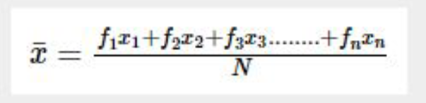
Arithmetic mean
Discrete Data Series continued…
For discrete series, the Arithmetic Mean can be calculated using the following formula.
Formula
Image Source :https://www.tutorialspoint.com/statistics/discrete_series_arithmetic_mean.htm
Notes:
Left (White Color space):
Title - Parent Topic
Subtitle - Subtopic 1
Body Text - Description in bullets
Right (Grey Color Space):
Body Text - Relevant image (with source)/code snippet
Put reference links in Speaker Notes
Reference:
https://www.tutorialspoint.com/internet_technologies/internet_overview.htm/

Slide 36
Arithmetic mean
Discrete Data Series continued…
Alternatively, we can write same formula as follows:
Formula
Image Source :https://www.tutorialspoint.com/statistics/discrete_series_arithmetic_mean.htm
Notes:
Left (White Color space):
Title - Parent Topic
Subtitle - Subtopic 1
Body Text - Description in bullets
Right (Grey Color Space):
Body Text - Relevant image (with source)/code snippet
Put reference links in Speaker Notes
Reference:
https://www.tutorialspoint.com/internet_technologies/internet_overview.htm/

Slide 37
Arithmetic mean
Continuous Data Series
When data is given based on ranges along with their frequencies. Following is an example of continuous series:
Items: 0-5 5-10 10-20 20-30 30-40
Frequency: 2 5 1 3 12
Image Source :https://www.tutorialspoint.com/statistics/discrete_series_arithmetic_mean.htm
Notes:
Left (White Color space):
Title - Parent Topic
Subtitle - Subtopic 1
Body Text - Description in bullets
Right (Grey Color Space):
Body Text - Relevant image (with source)/code snippet
Put reference links in Speaker Notes
Reference:
https://www.tutorialspoint.com/internet_technologies/internet_overview.htm/

Slide 38
Arithmetic mean
Continuous Data Series continued…
Image Source :https://www.tutorialspoint.com/statistics/discrete_series_arithmetic_mean.htm
Notes:
Left (White Color space):
Title - Parent Topic
Subtitle - Subtopic 1
Body Text - Description in bullets
Right (Grey Color Space):
Body Text - Relevant image (with source)/code snippet
Put reference links in Speaker Notes
Reference:
https://www.tutorialspoint.com/internet_technologies/internet_overview.htm/

Slide 39
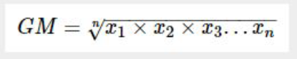
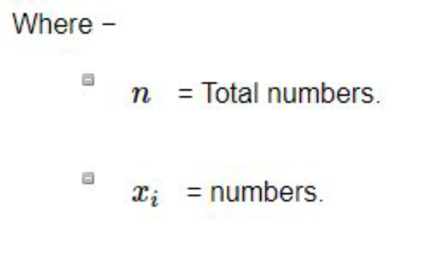
Arithmetic mean
Geometric mean
Geometric mean of n numbers is defined as the nth root of the product of n numbers.
Formula :
Image Source :https://www.tutorialspoint.com/statistics/geometric_mean.htm
Notes:
Left (White Color space):
Title - Parent Topic
Subtitle - Subtopic 1
Body Text - Description in bullets
Right (Grey Color Space):
Body Text - Relevant image (with source)/code snippet
Put reference links in Speaker Notes
Reference:
https://www.tutorialspoint.com/internet_technologies/internet_overview.htm/

Slide 40
Harmonic mean
What is Harmonic Mean ?
Harmonic mean is a type of average that is calculated by dividing the number of values in a data series by the sum of the reciprocals (1/x_i) of each value in the data series.
A harmonic mean is one of the three Pythagorean means (the other two are arithmetic mean and geometric mean).
The harmonic mean always shows the lowest value among the Pythagorean means.
Image Source:https://www.google.com/url?sa=i&source=imgres&cd=&cad=rja&uact=8&ved=2ah UKEwiz-cCqgLnqAhURcCsKHQfvCocQjRx6BAgBEAQ&url=https%3A%2F%2Fde
Notes:
Left (White Color space):
Title - Parent Topic
Subtitle - Subtopic 1
Body Text - Description in bullets
Right (Grey Color Space):
Body Text - Relevant image (with source)/code snippet
Put reference links in Speaker Notes
Reference:
https://www.tutorialspoint.com/internet_technologies/internet_overview.htm/

Slide 41
Harmonic mean
Formula of Harmonic Mean
The general formula for calculating a harmonic mean is:
Harmonic mean = n / (Σ1/x_i)
Where: n – the number of the values in a dataset
x_i – the point in a dataset
The weighted harmonic mean can be calculated using the following formula:
Weighted Harmonic Mean = (Σw_i ) /(Σw_i/x_i) Where:
w_i – the weight of the data point
x_i – the point in a dataset.
Image Source:https://www.google.com/urlsa=i&source=imgres&cd=&cad=rja&uact=8&ved=2ah UKEwiz-cCqgLnqAhURcCsKHQfvCocQjRx6BAgBEAQ&url=https%3A%2F%2Fde
Notes:
Left (White Color space):
Title - Parent Topic
Subtitle - Subtopic 1
Body Text - Description in bullets
Right (Grey Color Space):
Body Text - Relevant image (with source)/code snippet
Put reference links in Speaker Notes
Reference:
https://www.tutorialspoint.com/internet_technologies/internet_overview.htm/

Slide 42
Harmonic mean
Formula of Harmonic Mean
The general formula for calculating a harmonic mean is:
Harmonic mean = n / (Σ1/x_i)
Where: n – the number of the values in a dataset
x_i – the point in a dataset
The weighted harmonic mean can be calculated using the following formula:
Weighted Harmonic Mean = (Σw_i ) /(Σw_i/x_i) Where:
w_i – the weight of the data point
x_i – the point in a dataset.
Image Source: https://www.geeksforgeeks.org/difference-between-descriptive-and-inferential-statistics/
Notes:
Left (White Color space):
Title - Parent Topic
Subtitle - Subtopic 1
Body Text - Description in bullets
Right (Grey Color Space):
Body Text - Relevant image (with source)/code snippet
Put reference links in Speaker Notes
Reference:
https://www.tutorialspoint.com/internet_technologies/internet_overview.htm/

Slide 43
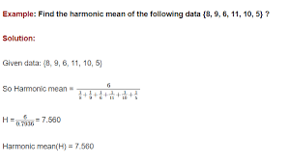
Harmonic mean
Example of Harmonic Mean
Firstly, we need to find the P/E ratios of each company. Remember that the P/E ratio is essentially the market capitalization divided by the earnings.
P/E (Company A) = ($1 billion) / ($20 million) = 50
P/E (Company B) = ($20 billion) / ($5 billion) = 4
Image Source:https://www.google.com/urlsa=i&source=imgres&cd=&cad=rja&uact=8&ved=2ah UKEwiz-cCqgLnqAhURcCsKHQfvCocQjRx6BAgBEAQ&url=https%3A%2F%2Fde
Notes:
Left (White Color space):
Title - Parent Topic
Subtitle - Subtopic 1
Body Text - Description in bullets
Right (Grey Color Space):
Body Text - Relevant image (with source)/code snippet
Put reference links in Speaker Notes
Reference:
https://www.tutorialspoint.com/internet_technologies/internet_overview.htm/

Slide 44
Harmonic mean
Example of Harmonic Mean
We must use the weighted harmonic mean to calculate the P/E ratio of the index. Using the formula for the weighted harmonic mean, the P/E ratio of the index can be found in the following way:
P/E (Index) = (0.4+0.6) / (0.4/50 + 0.6/4)= 6.33
Note that if we calculate the P/E ratio of the index using the weighted arithmetic mean, it would be significantly overstated:
P/E (Index) = 0.4×50 + 0.6×4 = 22.4
Image Source:https://www.google.com/urlsa=i&source=imgres&cd=&cad=rja&uact=8&ved=2ah UKEwiz-cCqgLnqAhURcCsKHQfvCocQjRx6BAgBEAQ&url=https%3A%2F%2Fde
Notes:
Left (White Color space):
Title - Parent Topic
Subtitle - Subtopic 1
Body Text - Description in bullets
Right (Grey Color Space):
Body Text - Relevant image (with source)/code snippet
Put reference links in Speaker Notes
Reference:
https://www.tutorialspoint.com/internet_technologies/internet_overview.htm/

Slide 45
Median in Raw and Grouped Data
Median in Raw Data
The median of raw data is the number which divides the observations when arranged in an order (ascending or descending) in two equal parts.
Image Source: https://www.math-only-math.com/images/median-of-raw-data.png
Notes:
Left (White Color space):
Title - Parent Topic
Subtitle - Subtopic 1
Body Text - Description in bullets
Right (Grey Color Space):
Body Text - Relevant image (with source)/code snippet
Put reference links in Speaker Notes
Reference:
https://www.tutorialspoint.com/internet_technologies/internet_overview.htm/

Slide 46
Median in Raw and Grouped Data
Method of finding median
Take the following steps to find the median of raw data.
Step I: Arrange the raw data in ascending or descending order.
Step II: Observe the number of variates in the data. Let the number of variates in the data be n. Then find the median as following.
(i) If n is odd then [Math Processing Error]th variate is the median
Image Source: https://www.math-only-math.com/images/median-of-raw-data.png
Notes:
Left (White Color space):
Title - Parent Topic
Subtitle - Subtopic 1
Body Text - Description in bullets
Right (Grey Color Space):
Body Text - Relevant image (with source)/code snippet
Put reference links in Speaker Notes
Reference:
https://www.tutorialspoint.com/internet_technologies/internet_overview.htm/

Slide 47
Median in Raw and Grouped Data
Method of finding median
(ii) If n is even then the mean of [Math Processing Error]th and ([Math Processing Error] + 1)th variates is the median, i.e.,
median = [Math Processing Error].
Image Source: https://www.math-only-math.com/images/median-of-raw-data.png
Notes:
Left (White Color space):
Title - Parent Topic
Subtitle - Subtopic 1
Body Text - Description in bullets
Right (Grey Color Space):
Body Text - Relevant image (with source)/code snippet
Put reference links in Speaker Notes
Reference:
https://www.tutorialspoint.com/internet_technologies/internet_overview.htm/

Slide 48
Median in Raw and Grouped Data
Solved Examples on Median of Raw
Data
Find the median of the ungrouped data.
15, 18, 10, 6, 14
Solution:
Arranging variates in ascending order,
we get 6, 10, 14, 15, 18.
The number of variates = 5, which is odd.
Therefore, median = [Math Processing Error]th variate = 3rd variate
Image Source: https://www.math-only-math.com/images/median-of-raw-data.png
Notes:
Left (White Color space):
Title - Parent Topic
Subtitle - Subtopic 1
Body Text - Description in bullets
Right (Grey Color Space):
Body Text - Relevant image (with source)/code snippet
Put reference links in Speaker Notes
Reference:
https://www.tutorialspoint.com/internet_technologies/internet_overview.htm/

Slide 49
Median in Raw and Grouped Data
Finding Median for Grouped Data
Median is the value which occupies the middle position when all the observations are arranged in an ascending or descending order. It is a positional average.
(i) Construct the cumulative frequency distribution.
(ii) Find (N/2)th term
(iii) The class that contains the cumulative frequency N/2 is called the median class.
Image Source:
Notes:
Left (White Color space):
Title - Parent Topic
Subtitle - Subtopic 1
Body Text - Description in bullets
Right (Grey Color Space):
Body Text - Relevant image (with source)/code snippet
Put reference links in Speaker Notes
Reference:
https://www.tutorialspoint.com/internet_technologies/internet_overview.htm/

Slide 50
Median in Raw and Grouped Data
Finding Median for Grouped Data
(iv) Find the median by using the formula:
Where l = Lower limit of the median class,
f = Frequency of the median class
c = Width of the median class,
N = The total frequency (Σf)
m = cumulative frequency of the class preceding the median class
Image Source: https://www.onlinemath4all.com/images/formulaformedianiofgroupeddata.png
Notes:
Left (White Color space):
Title - Parent Topic
Subtitle - Subtopic 1
Body Text - Description in bullets
Right (Grey Color Space):
Body Text - Relevant image (with source)/code snippet
Put reference links in Speaker Notes
Reference:
https://www.tutorialspoint.com/internet_technologies/internet_overview.htm/

Slide 51
Median in Raw and Grouped Data
Solved Examples on Median of
Grouped Data
A researcher studying the behavior of mice has recorded the time (in seconds) taken by each mouse to locate its food by considering 13 different mice as 31,33, 63, 33, 28, 29, 33, 27, 27, 34, 35,28, 32. Find the median time that mice spent in searching its food.
31, 33, 63, 33, 28, 29, 33, 27, 27, 34,35, 28, 32
Ascending order of given data is 27, 27, 28, 28, 29, 31, 32, 33, 33, 33,34, 35, 63
Middle value is 7th observation
Image Source:
Notes:
Left (White Color space):
Title - Parent Topic
Subtitle - Subtopic 1
Body Text - Description in bullets
Right (Grey Color Space):
Body Text - Relevant image (with source)/code snippet
Put reference links in Speaker Notes
Reference:
https://www.tutorialspoint.com/internet_technologies/internet_overview.htm/

Slide 52
Mode in Raw and Grouped Data
Finding the Mode in Raw Data
To find the mode, or modal value, it is best to put the numbers in order. Then count how many of each number. A number that appears most often is the mode.
3, 7, 5, 13, 20, 23, 39, 23, 40, 23, 14, 12, 56, 23, 29
In order these numbers are:
Image Source:
Notes:
Left (White Color space):
Title - Parent Topic
Subtitle - Subtopic 1
Body Text - Description in bullets
Right (Grey Color Space):
Body Text - Relevant image (with source)/code snippet
Put reference links in Speaker Notes
Reference:
https://www.tutorialspoint.com/internet_technologies/internet_overview.htm/

Slide 53
Mode in Raw and Grouped Data
Finding the Mode in Raw Data
3, 5, 7, 12, 13, 14, 20, 23, 23, 23, 23, 29, 39, 40, 56
This makes it easy to see which numbers appear most often.
This makes it easy to see which numbers appear most often.
In this case the mode is 23.
Image Source:
Notes:
Left (White Color space):
Title - Parent Topic
Subtitle - Subtopic 1
Body Text - Description in bullets
Right (Grey Color Space):
Body Text - Relevant image (with source)/code snippet
Put reference links in Speaker Notes
Reference:
https://www.tutorialspoint.com/internet_technologies/internet_overview.htm/

Slide 54
Mode in Raw and Grouped Data
Finding the Mode in Grouped Data
In some cases (such as when all values appear the same number of times) the mode is not useful. But we can group the values to see if one group has more than the others.
Example: {4, 7, 11, 16, 20, 22, 25, 26, 33}
Each value occurs once, so let us try to group them.
Image Source:
Notes:
Left (White Color space):
Title - Parent Topic
Subtitle - Subtopic 1
Body Text - Description in bullets
Right (Grey Color Space):
Body Text - Relevant image (with source)/code snippet
Put reference links in Speaker Notes
Reference:
https://www.tutorialspoint.com/internet_technologies/internet_overview.htm/

Slide 55
Mode in Raw and Grouped Data
Finding the Mode in Grouped Data
We can try groups of 10:
0-9: 2 values (4 and 7)
10-19: 2 values (11 and 16)
20-29: 4 values (20, 22, 25 and 26)
30-39: 1 value (33)
In groups of 10, the "20s" appear most often, so we could choose 25 (the middle of the 20s group) as the mode.
Image Source:
Notes:
Left (White Color space):
Title - Parent Topic
Subtitle - Subtopic 1
Body Text - Description in bullets
Right (Grey Color Space):
Body Text - Relevant image (with source)/code snippet
Put reference links in Speaker Notes
Reference:
https://www.tutorialspoint.com/internet_technologies/internet_overview.htm/

Slide 56
Standard Deviation
Standard Deviation Formulas
The Standard Deviation is a measure of how spread-out numbers are.
You might like to read this simpler page on Standard Deviation first.
But here we explain the formulas.
The symbol for Standard Deviation is σ (the Greek letter sigma).
This is the formula for Standard Deviation:
Image Source: https://www.mathsisfun.com/data/images/standard-deviation-formula.gif
Notes:
Left (White Color space):
Title - Parent Topic
Subtitle - Subtopic 1
Body Text - Description in bullets
Right (Grey Color Space):
Body Text - Relevant image (with source)/code snippet
Put reference links in Speaker Notes
Reference:
https://www.tutorialspoint.com/internet_technologies/internet_overview.htm/

Slide 57
Standard Deviation
Steps for Standard Deviation
Say we have a bunch of numbers like 9, 2, 5, 4, 12, 7, 8, 11.
To calculate the standard deviation of those numbers:
1. Work out the Mean (the simple average of the numbers)
2. Then for each number: subtract then Mean and square the result
3. Then work out the mean of those squared differences.
4. Take the square root of that and we are done!
Image Source:
Notes:
Left (White Color space):
Title - Parent Topic
Subtitle - Subtopic 1
Body Text - Description in bullets
Right (Grey Color Space):
Body Text - Relevant image (with source)/code snippet
Put reference links in Speaker Notes
Reference:
https://www.tutorialspoint.com/internet_technologies/internet_overview.htm/

Slide 58
Variance
What is Variance?
Variance is the expected value of the squared deviation of a random variable from its mean.
In short, it is the measurement of the distance of a set of random numbers from their collective average value.
Variance is used in statistics as a way of better understanding a data set's distribution.
Image Source: https://365datascience.com/wp-content/uploads/2018/09/image7.jpg
Notes:
Left (White Color space):
Title - Parent Topic
Subtitle - Subtopic 1
Body Text - Description in bullets
Right (Grey Color Space):
Body Text - Relevant image (with source)/code snippet
Put reference links in Speaker Notes
Reference:
https://www.tutorialspoint.com/internet_technologies/internet_overview.htm/

Slide 59
Variance
How does Variance work?
Variance is calculated by finding the square of the standard deviation of a variable, and the covariance of the variable with itself.
In the formula above, u represents the mean of the data points, x is the value of an individual data point, and N is the total number of data points.
Image Source: https://images.deepai.org/glossary-terms/variance-6302132.jpg
Notes:
Left (White Color space):
Title - Parent Topic
Subtitle - Subtopic 1
Body Text - Description in bullets
Right (Grey Color Space):
Body Text - Relevant image (with source)/code snippet
Put reference links in Speaker Notes
Reference:
https://www.tutorialspoint.com/internet_technologies/internet_overview.htm/

Slide 60
Variance
How to Calculate Variance?
(Continued)
Steps to Calculate Variance:
List elements of data set. The following are ages of students pursuing a Master’s degree:
Data set 1: 28,25,26,27,31,32,24
Calculate the mean.
(28 + 25 +26 +27 +31 +32 + 24) / 7 = 27.57
Image Source: https://www.onlinemathlearning.com/image-files/population-mean.png
Notes:
Left (White Color space):
Title - Parent Topic
Subtitle - Subtopic 1
Body Text - Description in bullets
Right (Grey Color Space):
Body Text - Relevant image (with source)/code snippet
Put reference links in Speaker Notes
Reference:
https://www.tutorialspoint.com/internet_technologies/internet_overview.htm/

Slide 61
Variance
How to Calculate Variance?
(Continued)
Find the deviation from the mean for each data point.
Image Source: https://s3.amazonaws.com/acadgildsite/wordpress_images/Data+Science/variance/image1.PNG
Notes:
Left (White Color space):
Title - Parent Topic
Subtitle - Subtopic 1
Body Text - Description in bullets
Right (Grey Color Space):
Body Text - Relevant image (with source)/code snippet
Put reference links in Speaker Notes
Reference:
https://www.tutorialspoint.com/internet_technologies/internet_overview.htm/

Slide 62
Variance
How to Calculate Variance?
(Continued)
Square it
Image Source: https://s3.amazonaws.com/acadgildsite/wordpress_images/Data+Science/variance/image1.PNG
Notes:
Left (White Color space):
Title - Parent Topic
Subtitle - Subtopic 1
Body Text - Description in bullets
Right (Grey Color Space):
Body Text - Relevant image (with source)/code snippet
Put reference links in Speaker Notes
Reference:
https://www.tutorialspoint.com/internet_technologies/internet_overview.htm/

Slide 63
Variance
=> (0.1849 + 6.6049 + 2.4649 + .3249 + 11.76 +
19.6249 + 12. 4609) / 7
⇒ 53.4303 /7 = 7.6329
⇒ Variance=7.6329
⇒ Standard Deviation=sqrt of Variance
How to Calculate Variance?
(Continued)
The average of all squared differences is the variance. To find it, add all squared variances and divide the sum by a number of elements in data set (n).
To find the standard deviation in ages of students pursuing Master’s, we calculate the square root of the variance
Image Source: https://s3.amazonaws.com/acadgildsite/wordpress_images/Data+Science/variance/image1.PNG
Notes:
Left (White Color space):
Title - Parent Topic
Subtitle - Subtopic 1
Body Text - Description in bullets
Right (Grey Color Space):
Body Text - Relevant image (with source)/code snippet
Put reference links in Speaker Notes
Reference:
https://www.tutorialspoint.com/internet_technologies/internet_overview.htm/

Slide 64
Variance
Applications of Variance
Variance plays a major role in interpreting data in statistics.
The most common application of variance is in polls.
For opinion polls, the data gathering agencies cannot invest in collecting data from the entire population.
They set criteria for sampling the population based on ethnicity, income group, regions, education level, salary and religion, so that the population is completely represented by the samples.
Image Source: https://3qeqpr26caki16dnhd19sv6by6v-wpengine.netdna-ssl.com/wp-content/uploads/2018/10/Line-Plot-Showing-Single-Model-Accuracy-blue-dots-vs-Accuracy-of-
Notes:
Left (White Color space):
Title - Parent Topic
Subtitle - Subtopic 1
Body Text - Description in bullets
Right (Grey Color Space):
Body Text - Relevant image (with source)/code snippet
Put reference links in Speaker Notes
Reference:
https://www.tutorialspoint.com/internet_technologies/internet_overview.htm/

Slide 65
Properties of Variance and standard deviation
Properties of Variance
Variance is a numerical value that describes the variability of observations from its arithmetic mean.
Variance is nothing but an average of squared deviations.
Variance is denoted by sigma-squared (σ2)
Variance is expressed in square units which are usually larger than the values in the given dataset.
Variance measures how far individuals.
Image Source: https://keydifferences.com/difference-between-variance-and-standard-deviation.ht
Notes:
Left (White Color space):
Title - Parent Topic
Subtitle - Subtopic 1
Body Text - Description in bullets
Right (Grey Color Space):
Body Text - Relevant image (with source)/code snippet
Put reference links in Speaker Notes
Reference:
https://www.tutorialspoint.com/internet_technologies/internet_overview.htm/

Slide 66
Properties of Variance and standard deviation
Properties of Variance
In statistics variance is defined as the measure of variability that represents how far members of a group are spread out.
It finds out the average degree to which each observation varies from the mean.
When the variance of a data set is small, it shows the closeness of the data points to the mean whereas a greater value of variance represents that the observations are very dispersed around
Image Source: https://keydifferences.com/difference-between-variance-and-standard-deviation.ht
Notes:
Left (White Color space):
Title - Parent Topic
Subtitle - Subtopic 1
Body Text - Description in bullets
Right (Grey Color Space):
Body Text - Relevant image (with source)/code snippet
Put reference links in Speaker Notes
Reference:
https://www.tutorialspoint.com/internet_technologies/internet_overview.htm/

Slide 67
Median in Raw and Grouped Data
Finding Median for Grouped Data
Median is the value which occupies the middle position when all the observations are arranged in an ascending or descending order. It is a positional average.
(i) Construct the cumulative frequency distribution.
(ii) Find (N/2)th term
(iii) The class that contains the cumulative frequency N/2 is called the median class.
Image Source:
Notes:
Left (White Color space):
Title - Parent Topic
Subtitle - Subtopic 1
Body Text - Description in bullets
Right (Grey Color Space):
Body Text - Relevant image (with source)/code snippet
Put reference links in Speaker Notes
Reference:
https://www.tutorialspoint.com/internet_technologies/internet_overview.htm/

Slide 68
Properties of Variance and standard deviation
Properties of Standard Deviation
Standard deviation is a measure that quantifies the amount of dispersion of the observations in a dataset.
The low standard deviation is an indicator of the closeness of the scores to the arithmetic mean and a high standard deviation represents.
The scores are dispersed over a higher range of values.
Image Source: https://keydifferences.com/difference-between-variance-and-standard-deviation.ht
Notes:
Left (White Color space):
Title - Parent Topic
Subtitle - Subtopic 1
Body Text - Description in bullets
Right (Grey Color Space):
Body Text - Relevant image (with source)/code snippet
Put reference links in Speaker Notes
Reference:
https://www.tutorialspoint.com/internet_technologies/internet_overview.htm/

Slide 69
Properties of Variance and standard deviation
Properties of Standard Deviation
Standard deviation is a measure of the
dispersion of observations within a data set relative to their mean.
The standard deviation is the root mean square deviation.
standard deviation is labelled as sigma (σ).
standard deviation which is expressed in the same units as the values in the set of data.
Standard Deviation measures how much
Image Source: https://www.educba.com/variance-vs-standard-deviation/
Notes:
Left (White Color space):
Title - Parent Topic
Subtitle - Subtopic 1
Body Text - Description in bullets
Right (Grey Color Space):
Body Text - Relevant image (with source)/code snippet
Put reference links in Speaker Notes
Reference:
https://www.tutorialspoint.com/internet_technologies/internet_overview.htm/

Slide 70
Properties of Variance and standard deviation
Example : To find Standard Deviation
and Variance
Marks scored by a student in five subjects are 60, 75, 46, 58 and 80 respectively.
You have to find out the standard deviation and variance.
First of all, you have to find out the mean,
Image Source: https://keydifferences.com/difference-between-variance-and-standard-deviation.ht
Notes:
Left (White Color space):
Title - Parent Topic
Subtitle - Subtopic 1
Body Text - Description in bullets
Right (Grey Color Space):
Body Text - Relevant image (with source)/code snippet
Put reference links in Speaker Notes
Reference:
https://www.tutorialspoint.com/internet_technologies/internet_overview.htm/

Slide 71
Properties of Variance and standard deviation
Example : To find Standard Deviation
and Variance
Now calculate the variance
Where, X = Observations
A = Arithmetic Mean
Both variance and standard deviation are always positive.
If all the observations in a data set are identical, then the standard deviation and variance will be zero.
Image Source: https://keydifferences.com/difference-between-variance-and-standard-deviation.ht
Notes:
Left (White Color space):
Title - Parent Topic
Subtitle - Subtopic 1
Body Text - Description in bullets
Right (Grey Color Space):
Body Text - Relevant image (with source)/code snippet
Put reference links in Speaker Notes
Reference:
https://www.tutorialspoint.com/internet_technologies/internet_overview.htm/

Slide 72
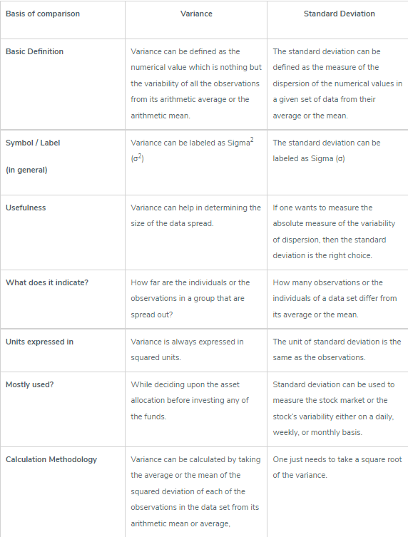
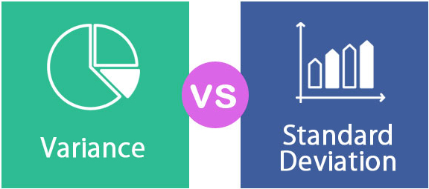
Properties of Variance and standard deviation
Image Source:
Notes:
Left (White Color space):
Title - Parent Topic
Subtitle - Subtopic 1
Body Text - Description in bullets
Right (Grey Color Space):
Body Text - Relevant image (with source)/code snippet
Put reference links in Speaker Notes
Reference:
https://www.tutorialspoint.com/internet_technologies/internet_overview.htm/

Slide 73
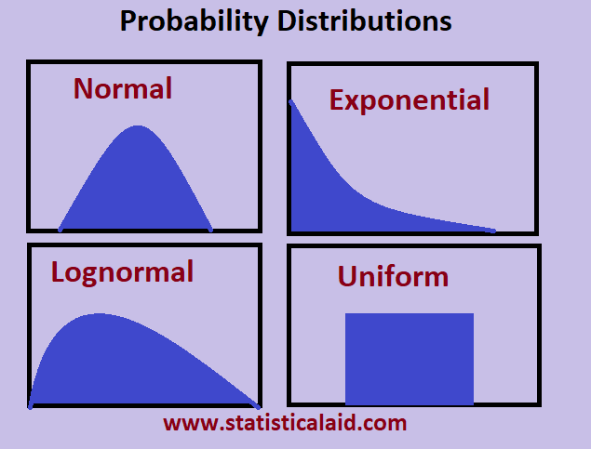
Types of Distributions
Data Distribution
Data distribution is a function that determines the values of a variable and quantifies relative frequency, it transforms raw data into graphical methods to give valuable information.
Image Source:
Notes:
Left (White Color space):
Title - Parent Topic
Subtitle - Subtopic 1
Body Text - Description in bullets
Right (Grey Color Space):
Body Text - Relevant image (with source)/code snippet
Put reference links in Speaker Notes
Reference:
https://www.tutorialspoint.com/internet_technologies/internet_overview.htm/

Slide 74
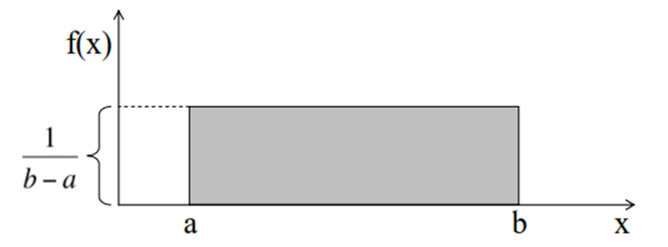
Types of Distributions
Uniform Distribution
The graph of a uniform distribution curve looks like
Uniform distribution can either be discrete or continuous where each event is equally likely to occur. It has a constant probability constructing a rectangular distribution.
A variable X is said to be uniformly distributed if the density function is:
Image Source: https://www.analyticsvidhya.com/blog/2017/09/6-probability-distributions-data-science/
Notes:
Left (White Color space):
Title - Parent Topic
Subtitle - Subtopic 1
Body Text - Description in bullets
Right (Grey Color Space):
Body Text - Relevant image (with source)/code snippet
Put reference links in Speaker Notes
Reference:
https://www.tutorialspoint.com/internet_technologies/internet_overview.htm/

Slide 75
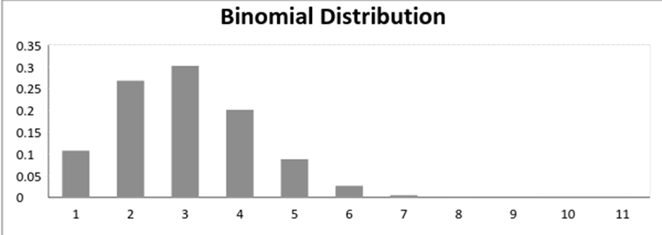
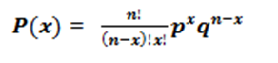
Types of Distributions
Binomial Distribution
A binomial distribution graph where the probability of success does not equal the probability of failure looks like
A distribution where only two outcomes are possible, such as success or failure, gain or loss, win or lose and where the probability of success and failure is same for all the trials is called a Binomial Distribution.
The mathematical representation of binomial distribution is given by:
Image Source: https://www.analyticsvidhya.com/blog/2017/09/6-probability-distributions-data-science/
Notes:
Left (White Color space):
Title - Parent Topic
Subtitle - Subtopic 1
Body Text - Description in bullets
Right (Grey Color Space):
Body Text - Relevant image (with source)/code snippet
Put reference links in Speaker Notes
Reference:
https://www.tutorialspoint.com/internet_technologies/internet_overview.htm/

Slide 76
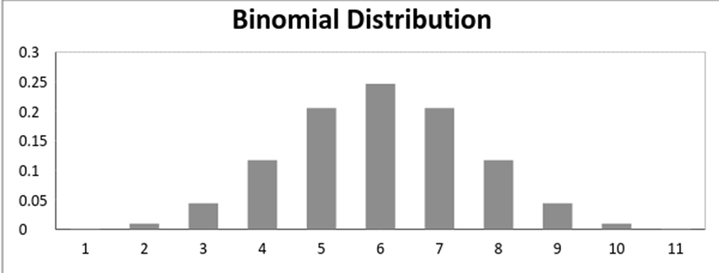
Types of Distributions
Binomial Distribution continued..
When probability of success = probability of failure, in such a situation the graph of binomial distribution looks like
Image Source: https://www.analyticsvidhya.com/blog/2017/09/6-probability-distributions-data-science/
Notes:
Left (White Color space):
Title - Parent Topic
Subtitle - Subtopic 1
Body Text - Description in bullets
Right (Grey Color Space):
Body Text - Relevant image (with source)/code snippet
Put reference links in Speaker Notes
Reference:
https://www.tutorialspoint.com/internet_technologies/internet_overview.htm/

Slide 77
Types of Distributions
Normal Distribution
Being a continuous distribution, the normal distribution is most commonly used in data science.
A very common process of our day to day life belongs to this distribution- income distribution, average employees report, average weight of a population, etc.
Image Source:
Notes:
Left (White Color space):
Title - Parent Topic
Subtitle - Subtopic 1
Body Text - Description in bullets
Right (Grey Color Space):
Body Text - Relevant image (with source)/code snippet
Put reference links in Speaker Notes
Reference:
https://www.tutorialspoint.com/internet_technologies/internet_overview.htm/

Slide 78
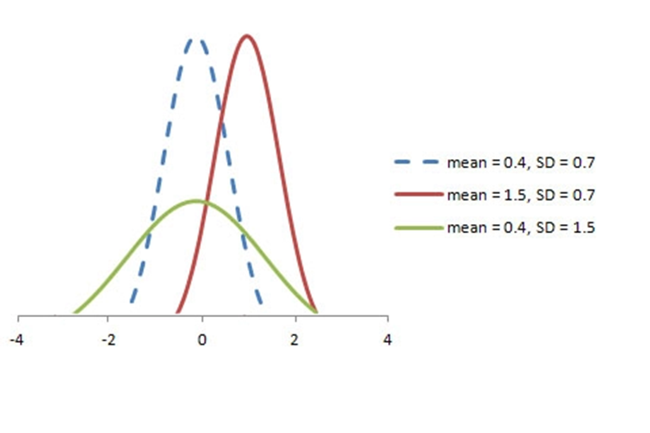
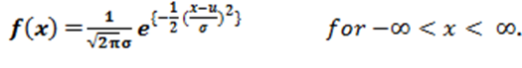
Types of Distributions
The graph of a random variable X ~ N (µ, σ) is shown below.
Normal Distribution
The PDF of a random variable X following a normal distribution is given by:
Image Source: https://www.analyticsvidhya.com/blog/2017/09/6-probability-distributions-data-science/
Notes:
Left (White Color space):
Title - Parent Topic
Subtitle - Subtopic 1
Body Text - Description in bullets
Right (Grey Color Space):
Body Text - Relevant image (with source)/code snippet
Put reference links in Speaker Notes
Reference:
https://www.tutorialspoint.com/internet_technologies/internet_overview.htm/

Slide 79
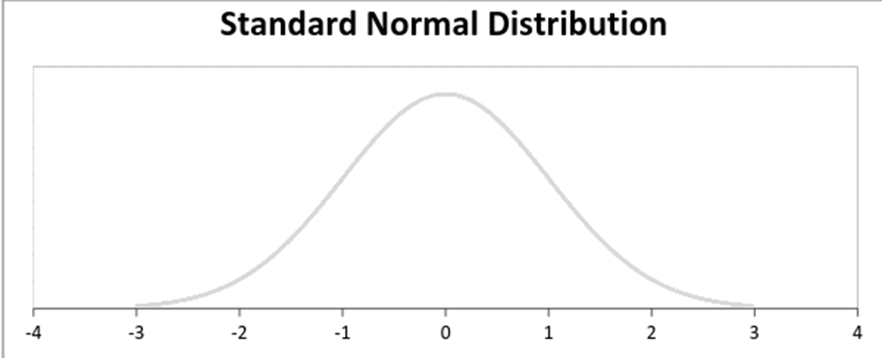
Types of Distributions
Normal Distribution
A standard normal distribution is defined as the distribution with mean 0 and standard deviation
Image Source: https://www.analyticsvidhya.com/blog/2017/09/6-probability-distributions-data-science/
Notes:
Left (White Color space):
Title - Parent Topic
Subtitle - Subtopic 1
Body Text - Description in bullets
Right (Grey Color Space):
Body Text - Relevant image (with source)/code snippet
Put reference links in Speaker Notes
Reference:
https://www.tutorialspoint.com/internet_technologies/internet_overview.htm/

Slide 80
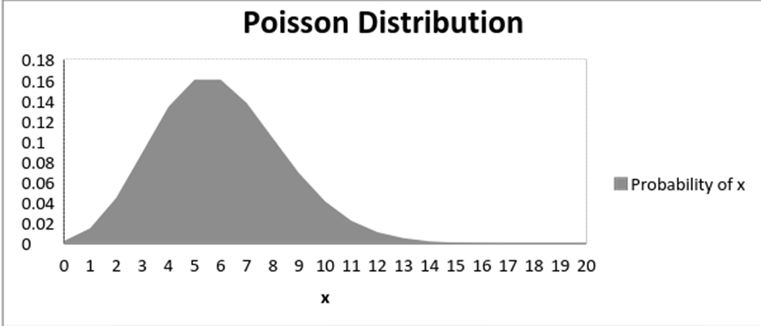
Types of Distributions
Poisson Distribution
The graph of a Poisson distribution is shown below:
A distribution is called Poisson distribution when the following assumptions are valid:
Any successful event should not influence the outcome of another successful event.
The probability of success over a short interval must equal the probability of success over a longer interval.
The probability of success in an interval approaches zero as the interval becomes smaller.
Image Source: https://www.analyticsvidhya.com/blog/2017/09/6-probability-distributions-data-science/
Notes:
Left (White Color space):
Title - Parent Topic
Subtitle - Subtopic 1
Body Text - Description in bullets
Right (Grey Color Space):
Body Text - Relevant image (with source)/code snippet
Put reference links in Speaker Notes
Reference:
https://www.tutorialspoint.com/internet_technologies/internet_overview.htm/

Slide 81
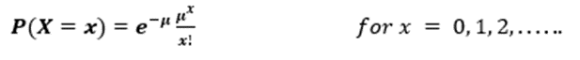
Types of Distributions
Poisson Distribution
Some notations used in Poisson distribution are:
λ is the rate at which an event occurs,
t is the length of a time interval,
And X is the number of events in that time interval.
Here, X is called a Poisson Random Variable and the probability distribution of X is called Poisson distribution.
Let µ denote the mean number of events in an interval of length t. Then, µ = λ*t.
The PMF of X following a Poisson distribution is given by:
Image Source: https://www.analyticsvidhya.com/blog/2017/09/6-probability-distributions-data-science/
Notes:
Left (White Color space):
Title - Parent Topic
Subtitle - Subtopic 1
Body Text - Description in bullets
Right (Grey Color Space):
Body Text - Relevant image (with source)/code snippet
Put reference links in Speaker Notes
Reference:
https://www.tutorialspoint.com/internet_technologies/internet_overview.htm/

Slide 82
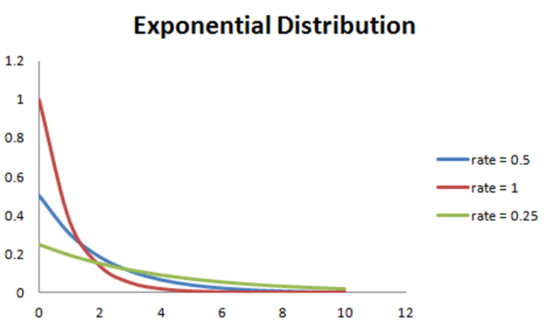
Types of Distributions
Exponential Distribution
Like the Poisson distribution, exponential distribution has the time element; it gives the probability of a time duration before an event takes place.
A random variable X is said to have an exponential distribution with PDF:
f(x) = { λe-λx, x ≥ 0
Image Source: https://www.analyticsvidhya.com/blog/2017/09/6-probability-distributions-data-science/
Notes:
Left (White Color space):
Title - Parent Topic
Subtitle - Subtopic 1
Body Text - Description in bullets
Right (Grey Color Space):
Body Text - Relevant image (with source)/code snippet
Put reference links in Speaker Notes
Reference:
https://www.tutorialspoint.com/internet_technologies/internet_overview.htm/

Slide 83
Sampling
What is sampling?
Sampling is a technique of selecting individual members or a subset of the population to make statistical inferences from them and estimate characteristics of the whole population.
Image Source: https://www.questionpro.com/blog/types-of-sampling-for-social-research/
Notes:
Left (White Color space):
Title - Parent Topic
Subtitle - Subtopic 1
Body Text - Description in bullets
Right (Grey Color Space):
Body Text - Relevant image (with source)/code snippet
Put reference links in Speaker Notes
Reference:
https://www.tutorialspoint.com/internet_technologies/internet_overview.htm/

Slide 84
Sampling
Sampling Example
If a drug manufacturer would like to research the adverse side effects of a drug on the country’s population, it is almost impossible to conduct a research study that involves everyone.
In this case, the researcher decides a sample of people from each demographic and then researches them, giving him/her indicative feedback on the drug’s behavior.
Image Source: https://www.questionpro.com/blog/types-of-sampling-for-social-research/
Notes:
Left (White Color space):
Title - Parent Topic
Subtitle - Subtopic 1
Body Text - Description in bullets
Right (Grey Color Space):
Body Text - Relevant image (with source)/code snippet
Put reference links in Speaker Notes
Reference:
https://www.tutorialspoint.com/internet_technologies/internet_overview.htm/

Slide 85
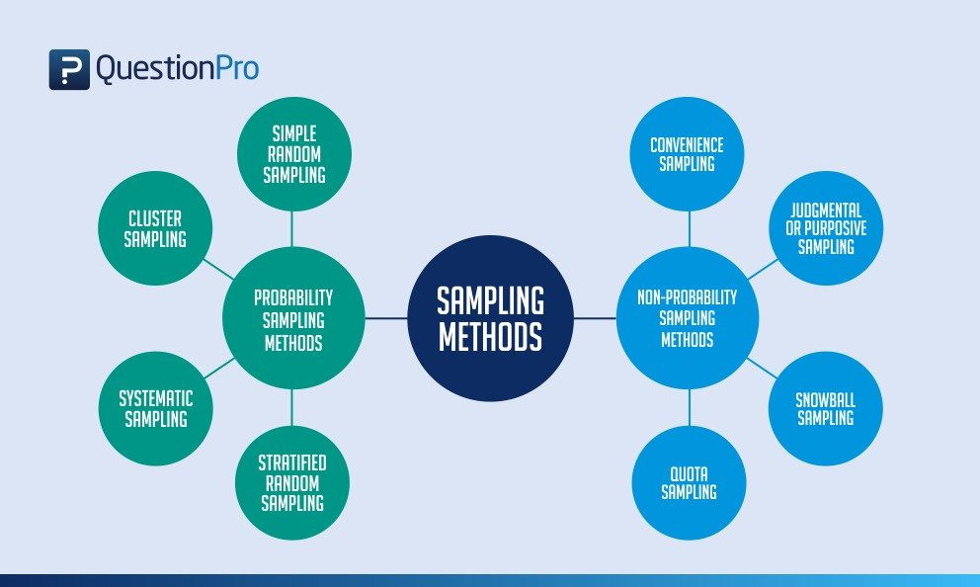
Sampling
Types of sampling: sampling methods
Probability sampling: Probability sampling is a sampling technique where a researcher sets a selection of a few criteria and chooses members of a population randomly.
All the members have an equal opportunity to be a part of the sample with this selection parameter.
Image Source: https://www.questionpro.com/blog/types-of-sampling-for-social-research/
Notes:
Left (White Color space):
Title - Parent Topic
Subtitle - Subtopic 1
Body Text - Description in bullets
Right (Grey Color Space):
Body Text - Relevant image (with source)/code snippet
Put reference links in Speaker Notes
Reference:
https://www.tutorialspoint.com/internet_technologies/internet_overview.htm/

Slide 86
Sampling
Types of sampling: sampling methods
Non-probability sampling: In non-probability sampling, the researcher chooses members for research at random.
This sampling method is not a fixed or predefined selection process. This makes it difficult for all elements of a population to have equal opportunities to be included in a sample.
Image Source: https://www.questionpro.com/blog/types-of-sampling-for-social-research/
Notes:
Left (White Color space):
Title - Parent Topic
Subtitle - Subtopic 1
Body Text - Description in bullets
Right (Grey Color Space):
Body Text - Relevant image (with source)/code snippet
Put reference links in Speaker Notes
Reference:
https://www.tutorialspoint.com/internet_technologies/internet_overview.htm/

Slide 87
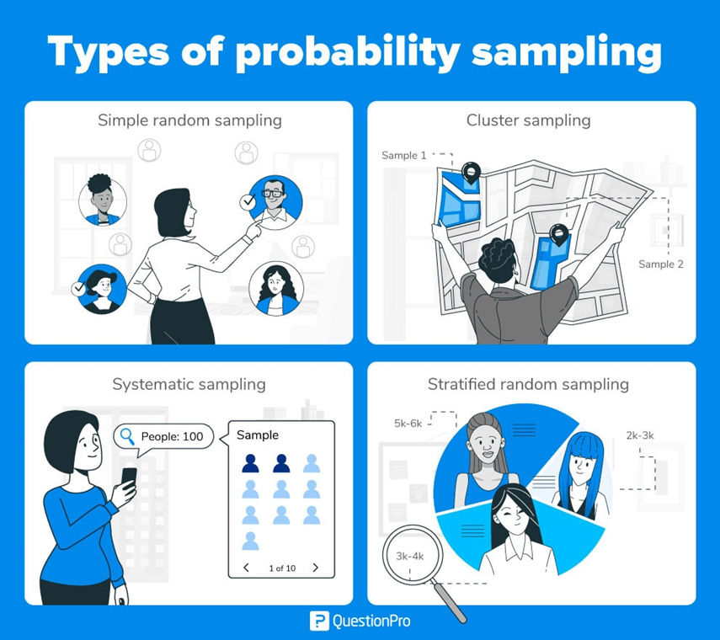
Sampling
Types of probability sampling
Probability sampling is a sampling technique in which researchers choose samples from a larger population using a method based on the theory of probability.
This sampling method considers every member of the population and forms samples based on a fixed process.
Image Source: https://www.questionpro.com/blog/types-of-sampling-for-social-research/
Notes:
Left (White Color space):
Title - Parent Topic
Subtitle - Subtopic 1
Body Text - Description in bullets
Right (Grey Color Space):
Body Text - Relevant image (with source)/code snippet
Put reference links in Speaker Notes
Reference:
https://www.tutorialspoint.com/internet_technologies/internet_overview.htm/

Slide 88
Sampling
Types of probability sampling
Simple random sampling: It is a reliable method of obtaining information where every single member of a population is chosen randomly, merely by chance.
Cluster sampling: It sampling is a method where the researchers divide the entire population into sections or clusters that represent a population.
Image Source: https://www.questionpro.com/blog/types-of-sampling-for-social-research/
Notes:
Left (White Color space):
Title - Parent Topic
Subtitle - Subtopic 1
Body Text - Description in bullets
Right (Grey Color Space):
Body Text - Relevant image (with source)/code snippet
Put reference links in Speaker Notes
Reference:
https://www.tutorialspoint.com/internet_technologies/internet_overview.htm/

Slide 89
Sampling
Types of probability sampling
Systematic sampling: This method to choose the sample members of a population at regular intervals. It requires the selection of a starting point for the sample and sample size that can be repeated at regular intervals.
Stratified random sampling: It is a method in which the researcher divides the population into smaller groups that don’t overlap but represent the entire population.
Image Source:https://www.questionpro.com/blog/types-of-sampling-for-social-research/
Notes:
Left (White Color space):
Title - Parent Topic
Subtitle - Subtopic 1
Body Text - Description in bullets
Right (Grey Color Space):
Body Text - Relevant image (with source)/code snippet
Put reference links in Speaker Notes
Reference:
https://www.tutorialspoint.com/internet_technologies/internet_overview.htm/

Slide 90
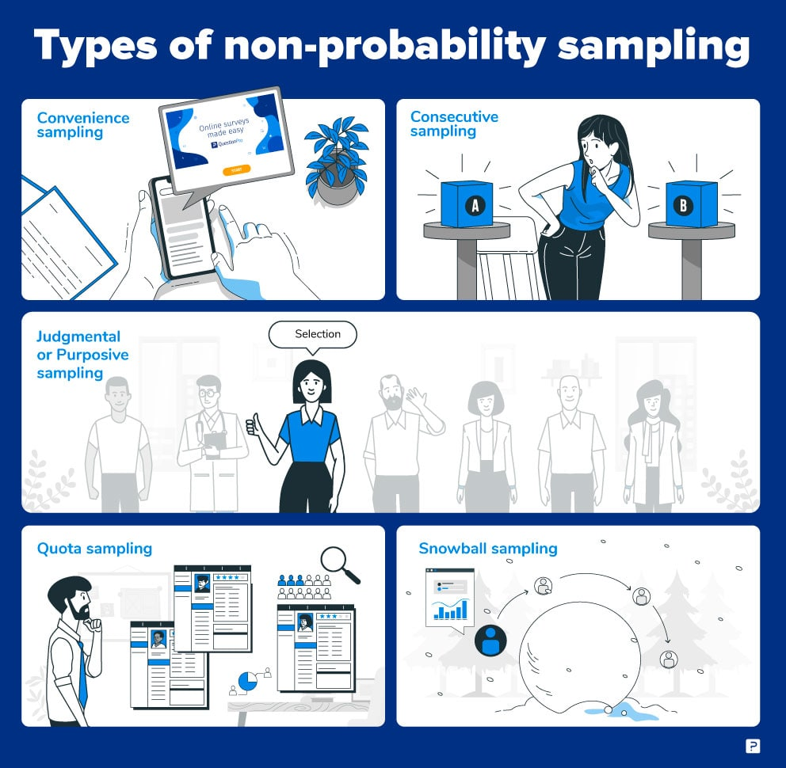
Sampling
Types of non-probability sampling
Convenience sampling: This method is dependent on the ease of access to subjects such as surveying customers at a mall or passers-by on a busy street.
Judgmental or purposive sampling: Judgmental or purposive samples are formed by the discretion of the researcher. Researchers purely consider the purpose of the study, along with the understanding of the target audience.
Image Source: https://www.questionpro.com/blog/types-of-sampling-for-social-research/
Notes:
Left (White Color space):
Title - Parent Topic
Subtitle - Subtopic 1
Body Text - Description in bullets
Right (Grey Color Space):
Body Text - Relevant image (with source)/code snippet
Put reference links in Speaker Notes
Reference:
https://www.tutorialspoint.com/internet_technologies/internet_overview.htm/

Slide 91
Sampling
Types of non-probability sampling
Snowball sampling: It is a sampling method that researchers apply when the subjects are difficult to trace.
Quota sampling: In Quota sampling, the selection of members in this sampling technique happens based on a pre-set standard. .
Image Source: https://www.questionpro.com/blog/types-of-sampling-for-social-research/
Notes:
Left (White Color space):
Title - Parent Topic
Subtitle - Subtopic 1
Body Text - Description in bullets
Right (Grey Color Space):
Body Text - Relevant image (with source)/code snippet
Put reference links in Speaker Notes
Reference:
https://www.tutorialspoint.com/internet_technologies/internet_overview.htm/

